Slide 1
Chapter 5

Slide 2
Read “The Story of Theatre” pg 136
Play Kahoot!https://play.kahoot.it/#/k/13243007-d5d3-4442-9bb0-85b240f21800
5,000 – 1,000 = 10/10
3,000 – 4,999 = 8/10
2,000 – 2,999 = 7/10
1,000 – 1,999 = 6/10
500 – 999 = 5/10
1 – 499 = 2/10
0 = 0/10

Slide 3
Memorizing Your Lines
Techniques:
Run them with someone else over and over
Hand copy every line (thinking about the lines as you write)
Record lines on your phone and listen
Important reminder
As you memorize, put the emotions/feeling with each line

Slide 4
Learn your lines as written!
It might cue another actor
It might set something later in play
It might need to be echoed by another character
It might be funny with certain word choice
Ruining might spoil the timing or rhythm
Don’t hold the production up by not being off-book

Slide 5
Voice Production
What makes an effective speaking voice? (intelligibility)!
Loudness
Enunciation
Standards of Pronunciation
Speaking Rate
Vocal Variety
Stress/Emphasis
Emotional Quality

Slide 6
Relaxation Techniques
Beat Stage Fright through Relaxation
Need a positive attitude (not what could go wrong)
Be prepared
Trust your fellow company members
Trust your audience
Physical warm-ups – expend nervous energy
Mental warm-ups – imagining refreshing images/energizing images

Slide 7
Problem Solving Questions
Answer with your table

Slide 8
#J21 Carelessly Enunciated Words
Write the correct spelling of the words below in your journal:
Probly | Yer | Twunny
Tuh | Becuz | Sposta
Hafta | Gunna | Wanna
Goinn | Lotta | Useta
Gimme | Cuppa | Pertect
Lemme | Getcha
As a class, say each out loud!

Slide 9
Housekeeping and Safety (Power Tools)
Be careful around scene shop!
Always wear safety goggles with machinery
Check cords/tools
Don’t play games around equipment
Don’t use faulty equipment

Slide 10
Basic Safety with Set
Don’t climb ladders alone
Have at least two bolts to strengthen something
Sweep the stage before rehearsal and after set day (sweep broken glass immediately)
Check sturdiness of furniture
Schedule Breaks
Know the location of first aid

Slide 11
Design elements
Visual design for any work of art:

Slide 12
Point
Single Medium
Paint/Fabric/Light
Example: single down spotlight cutting through dark stage
Relate to spot instantly
Creation of implied lines/implied shapes

Slide 13
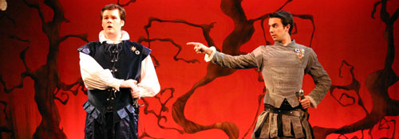
Line
Continuous Mark Produced by a Point
Straight lines = singularity of purpose, Angled = abrupt change in position
Curved can mean many things
Confusion, or gentle=comfort
Sharp/crisp = meticulous, fuzzy, curved = reassurance

Slide 14
Line, cont.
Lines on set/costume – platforms/flats
Line going up = specific ideas (hope/strength/optimism)
Going down = weakness, frailty
Vertical forceful and strong
Diagonal = dynamic, feeling of movement

Slide 15
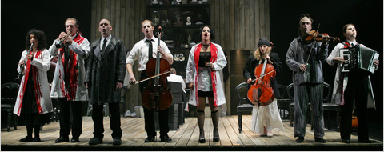
SHAPE
Organic – curved, shapes found in nature
Geometric – angular, straight, rigid
Positive space – area inhabited by shapes on stage
Negative space – spaces that surround shapes

Slide 16
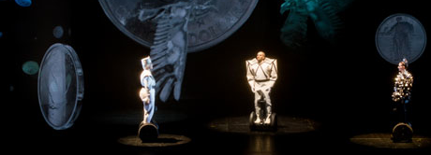
Mass (also known as form)
Added dimension of depth
Geometric/Organic
Dimensions of mass enhanced/revealed through chiaroscuro (3-D effect) – look in book
Manipulated forms called abstract shapes

Slide 17
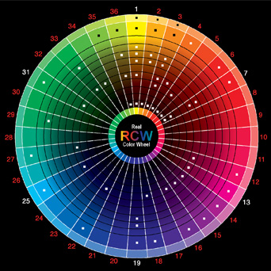
Color
Involves light
Placement on color wheel shows relationship (complementary colors – intensity and brightness of each color affected) – insert in middle of book

Slide 18
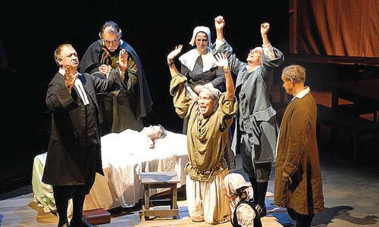
Value
Use of Black and White
Painting legs of platforms black to make them disappear – “backstage blacks”
Sometimes use of black imperative for costuming –
nuns/priests - Black drapes mask and characters not visible
White reflects any and all light
Ok to use tented white – avoiding lighting issues with true white

Slide 19
Texture
Surface quality: relative smoothness
Example: brick, or imitation painted brick (implied)
Fabrics
Tactile – feel: through silk, burlap, etc.
Implied – through patterns/prints/etc,
Lighting – through gobo – metal sheet to create shadow pattern

Slide 20
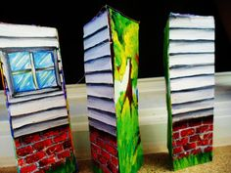
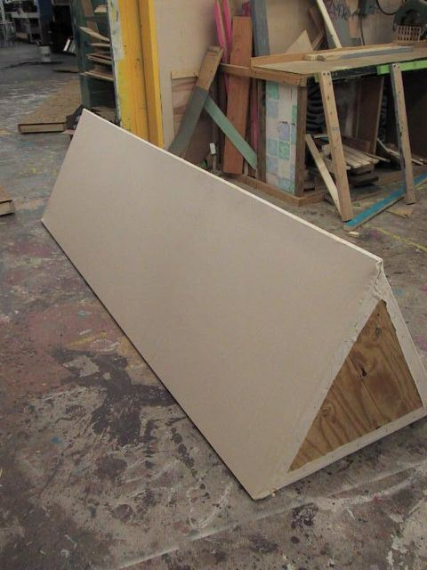
Create a Periaktos
Need to create 3 different scenes from a MUSICAL OF YOUR CHOICE (may work with one other person)
Need to have 3 total!
___/6 - 3 different scenes
___/6 - 3 total Periaktos
___/4 - in color
___/4 - effot
___/20 - TOTAL

Slide 21
#J22
Pre-relaxation techniques:
What do you think the benefit is from relaxing?

Slide 22
#J22, continued
Post-relaxation techniques:
After having gone through relaxation techniques – what did you notice?

