Slide 1
Welcome to A new year!

Slide 2
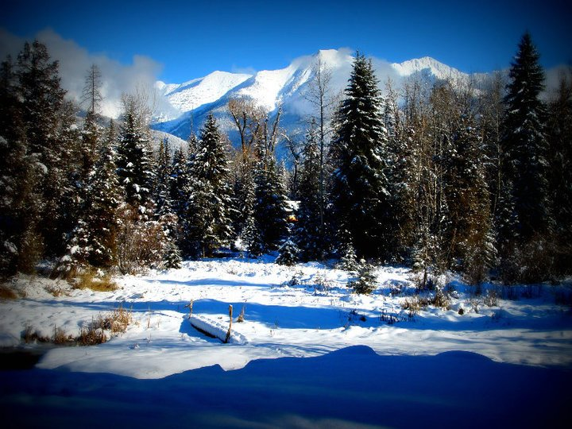
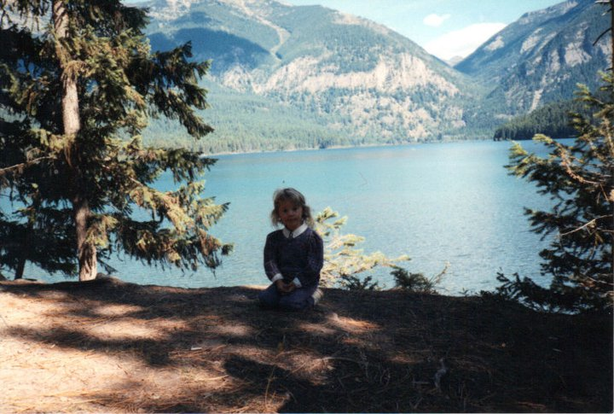
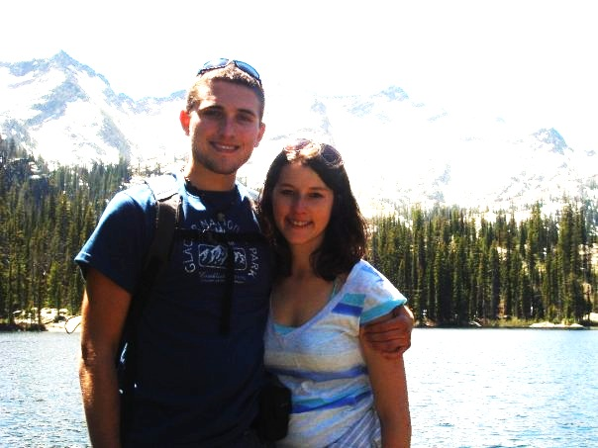
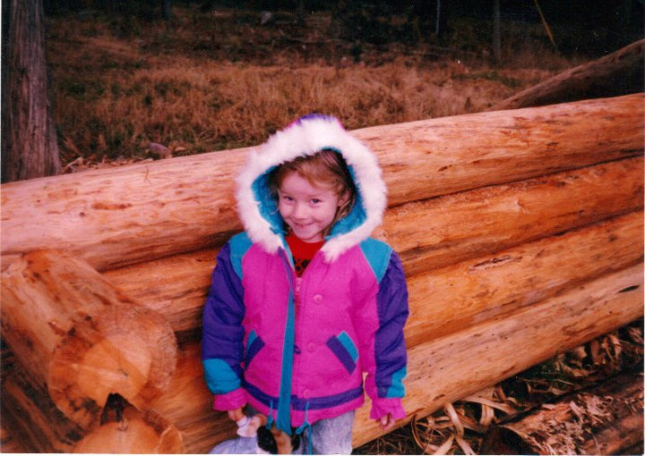
About myself…
I was born in Kalispell, MT and grew up in a log cabin in Swan Valley, MT

Slide 3
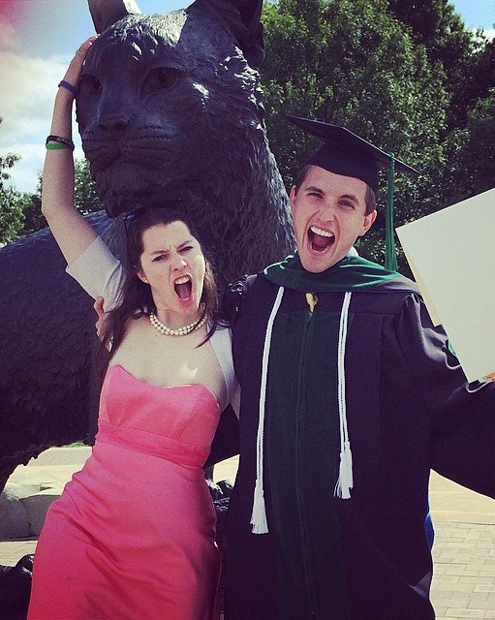
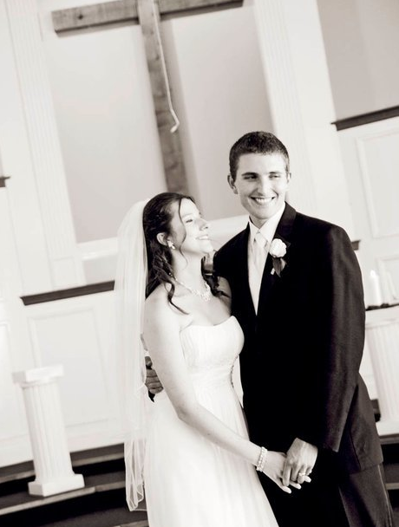
I married my college sweetheart 3 years ago – AKA the “coolest person ever” – Dr. Mitchell Strohmaier

Slide 4
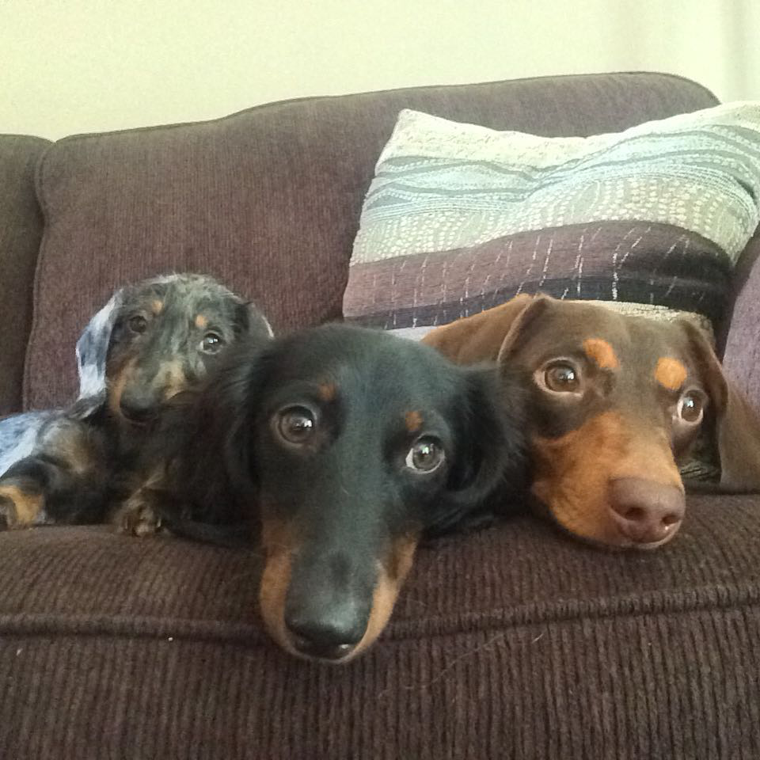
3. We have 3… yes, 3 wiener dogs!

Slide 5
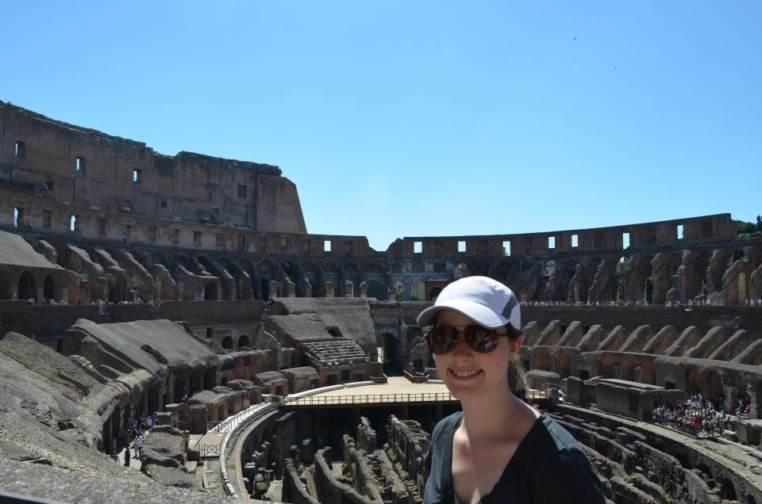
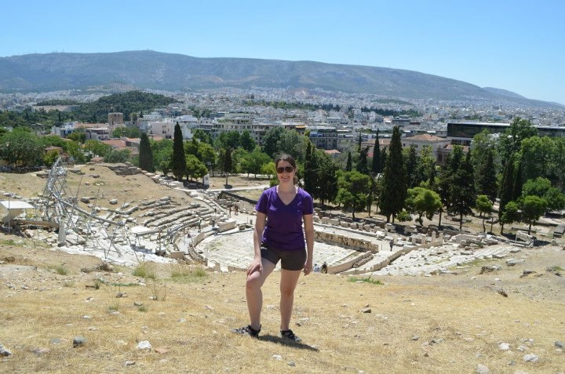
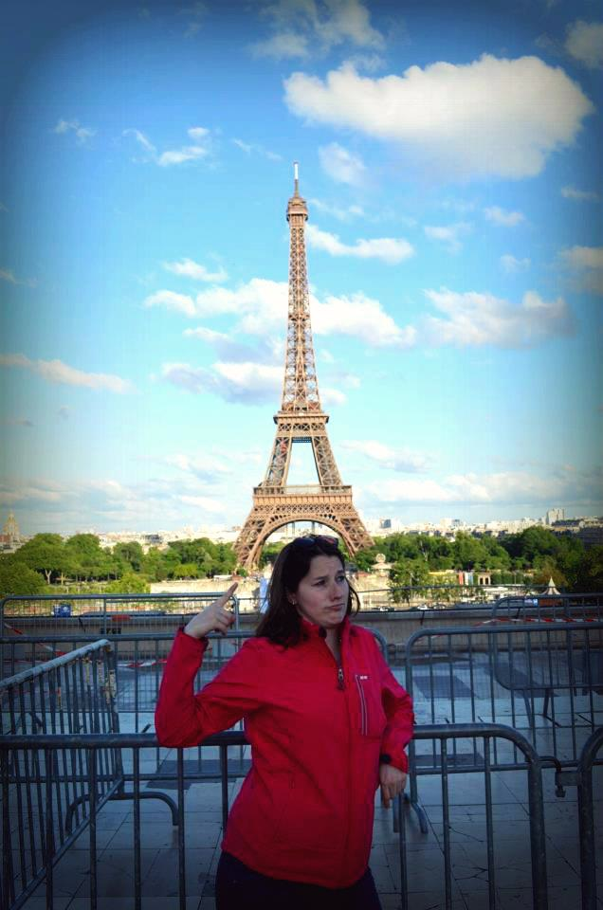
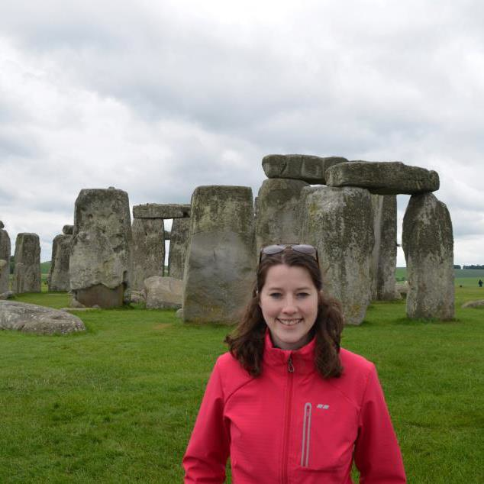
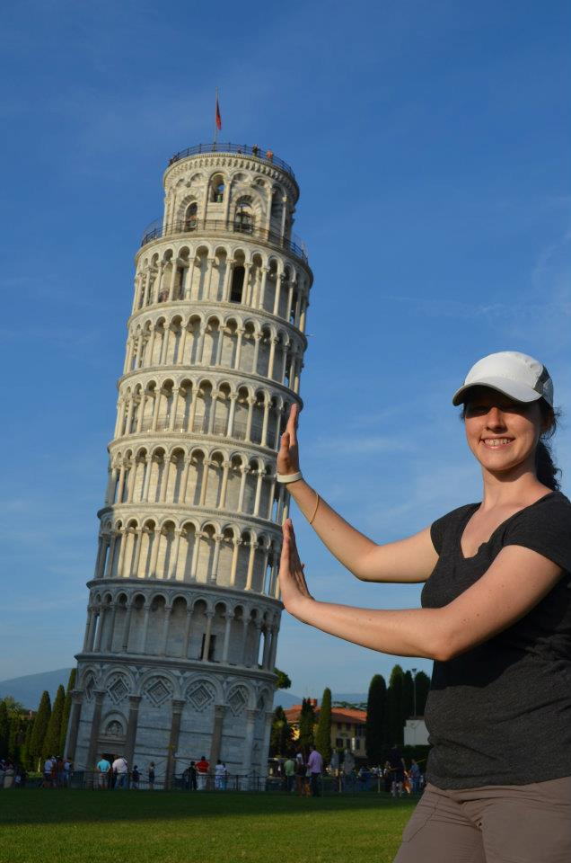
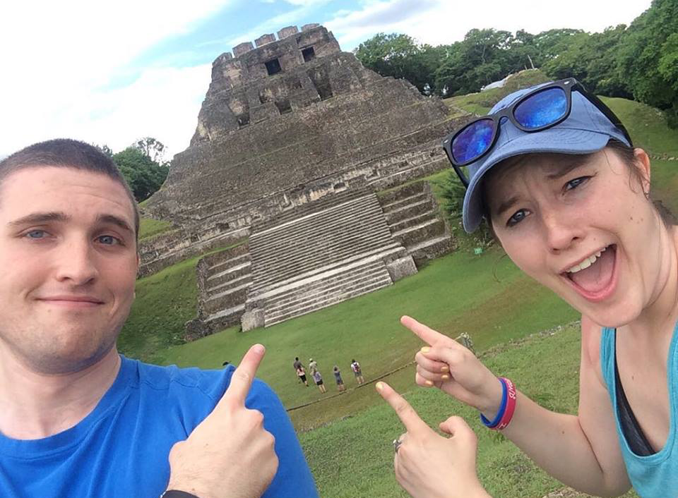
4. I LOVE to travel. In fact, I’ve been to 46 states and 15 countries
…(if you count The Vatican and US)

Slide 6
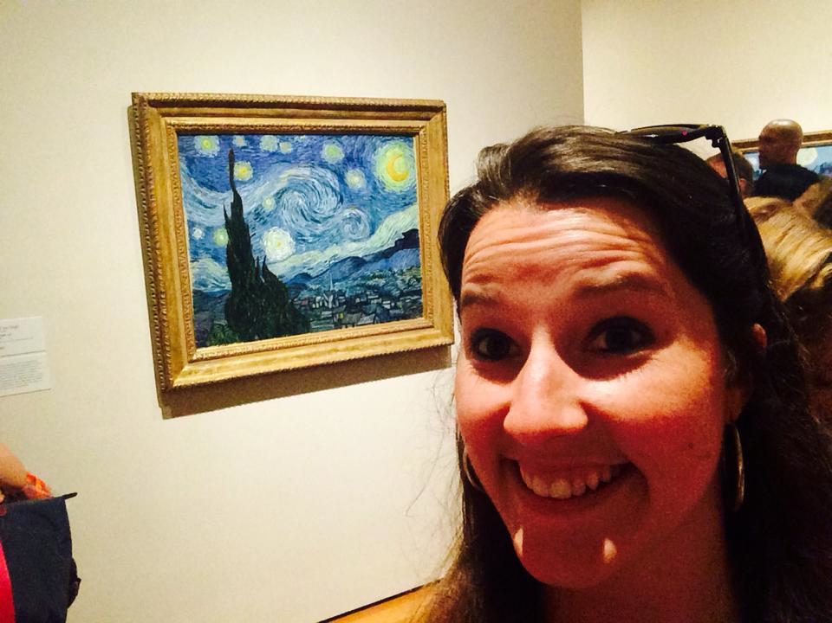
5. I LOVE the arts! ☺ I used to act quite a bit (theatre major), I play guitar and sing, and my dad is a professional artist. Now, I direct plays at Lafayette!

Slide 7
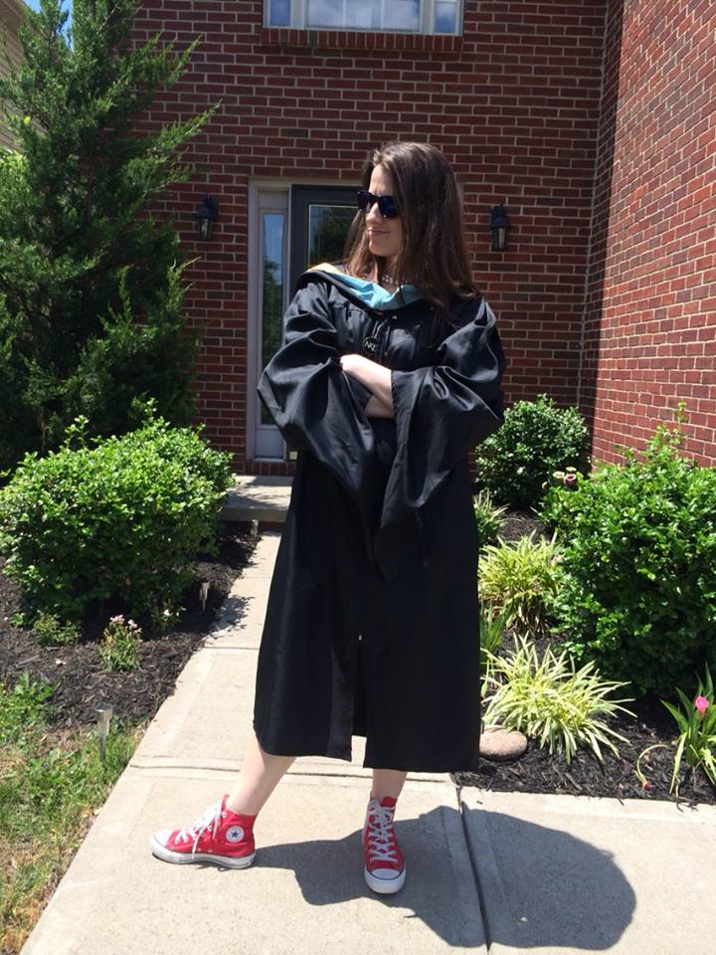
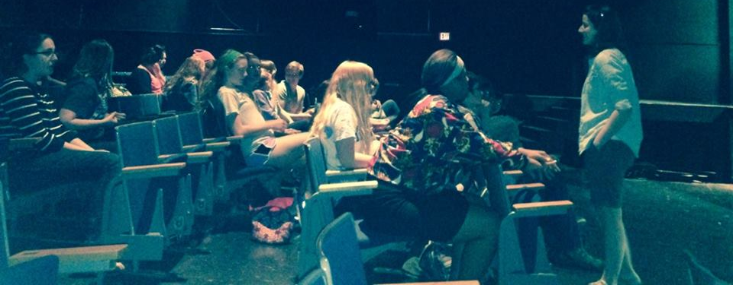
6. I LOVE Lafayette!

Slide 8
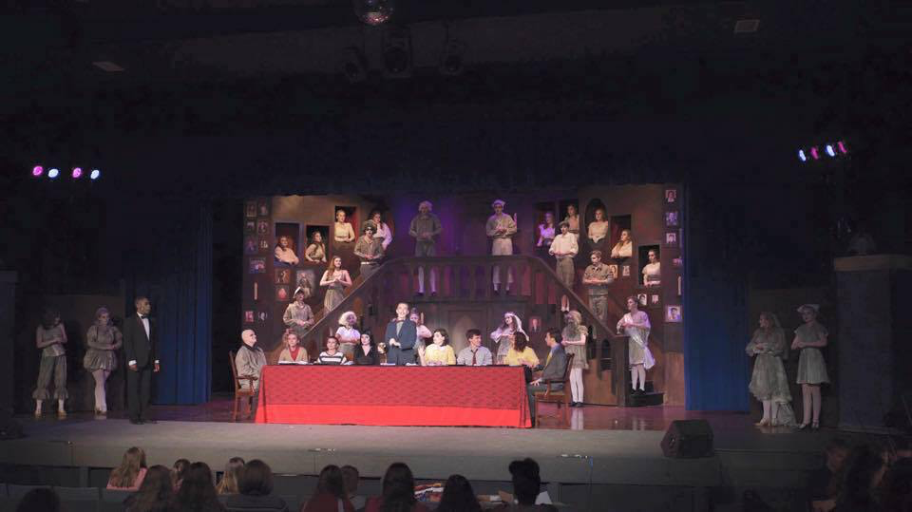

Slide 9
Syllabus
Description
Content
Goals
Assessment
Policies

Slide 10
Grading
Formative – 40%
Summative – 45%
Final – 15%

Slide 11
Expectations
Respect
Leave only with permission (ASK)
Your responsibility to make up work
BE DEPENDABLE!
WORK MUST BE YOUR OWN
Bring PEN/PENCIL/PAPER/BINDER everyday!
(VPA, drama activities, drama 4 – no binder)
PARTICIPATE (in and out of class)

Slide 12
LATE WORK
Full points for excused absence (bring in the day after absent!)
YOU are responsible for getting your work (on my door)
Turn in stuff at the beginning of class
Papers are accepted only ONE day late for up 10% credit off
After will be 50% off, work turned in after date = 0%
Big projects are due on the day!

Slide 13
Hall Passes
Given 4 hall passes – only for emergencies!!!
MUST have it when you return
I keep a record on the back closet (I notice if you don’t check out, I’m not stupid).
Only be gone for 5 minutes – I call the front office to find you.
Hall passes do not carry over.

Slide 14
Plagiarism
Don’t do it – I will write you up. It’s not fun.

Slide 15
Food/drink policy
NONE EVER EVER EVER EVER IN THE AUDITORIUM!
…….ONLY WATER

Slide 16
DRAMA

Slide 17
HW
Bring in your parent/guardian signature
Write 3 classroom rules you think we as a class/theatre students need.
Bring in both for Friday.

Slide 18
Twitter/Facebook
@Mrs_Strohmaier
@Lafayette_Drama
FB: Mrs. Strohmaier – Lafayette High School
FB: Lafayette High School Drama Department

Slide 19
Remind 101
To receive messages via text:
A2 – TEXT:
@a2drama1 to 81010
B1 – TEXT:
@b1drama1 to 81010.

Slide 20
Auditions
Monday – August 17
*One Flew Over the Cuckoo’s Nest and The Importance of Being Earnest
30 second to 1 min monologue
Tuesday – August 18
*Potential Callbacks for Cuckoo’s Nest (after school)
Wednesday – August 19
*One Flew Over the Cuckoo’s Nest Read Through
parent meeting at 6pm
August 20, 24, 25, 26, 27, 28
*Before School – tech interviews (sign up on the callboard)

Slide 21
Getting to Know yoU!
Find students in the class that are the “answers” on the sheet!

Slide 22
Class RUles
With your table:
Come up with four rules you think should be implemented in class.

