Slide 1
Drama 1 – 8/14
Rules for Class
Audition Info
Lip Sync Info.
Chapt 1 notes
Character Analysis for Lip Sync

Slide 2
Let’s create for this class.
Think about what will be necessary for the class (including using the stage)
Hint: you need your three rules you made up

Slide 3
Auditions
Monday – August 17
*One Flew Over the Cuckoo’s Nest
30 second monologue (all)

Slide 4
Advice
Fill out your audition packet – list important info that can help (can bring headshot/resume)
Don’t make excuses – be confident
Dress appropriately
Follow directions – 30 sec/1 min, 16 bars
Find a song/monologue that connects to the character you want

Slide 6
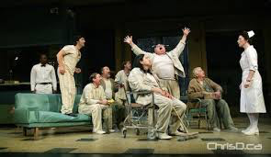
One Flew Over the Cuckoo’s Nest
McMurphy, Harding, Billy
Nurse Ratched

Slide 7
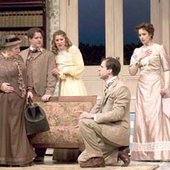
The Importance of Being Earnest
Earnest, Algernon
Cecily, Gwendolyn, Lady Bracknel

Slide 8
Lip Sync
Believable – committed to character!
Lip sync – do you know your song?
Gestures/movement – expressive or being made up on the spot
Physicality – varied?
Stage presence – command attention!
keep your rubric (points off if I have to provide one)

